Slide 1
On Solving Relational Equations
Shu-Cherng Fang
Industrial Engineering and Operations Research
North Carolina State University
Raleigh, NC 27695-7906, U.S.A
www.ie.ncsu.edu/fangroup
December 19, 2002

Slide 2
Outline
Relational Equations
Motivations
Triangular Norms
Fuzzy Relational Equations
Characteristics of Solution Sets
Extensions
  Interval Valued Fuzzy Relation Equations (IVFRE)
  Optimization with Fuzzy Relation Equations
Challenges Remain

Slide 3
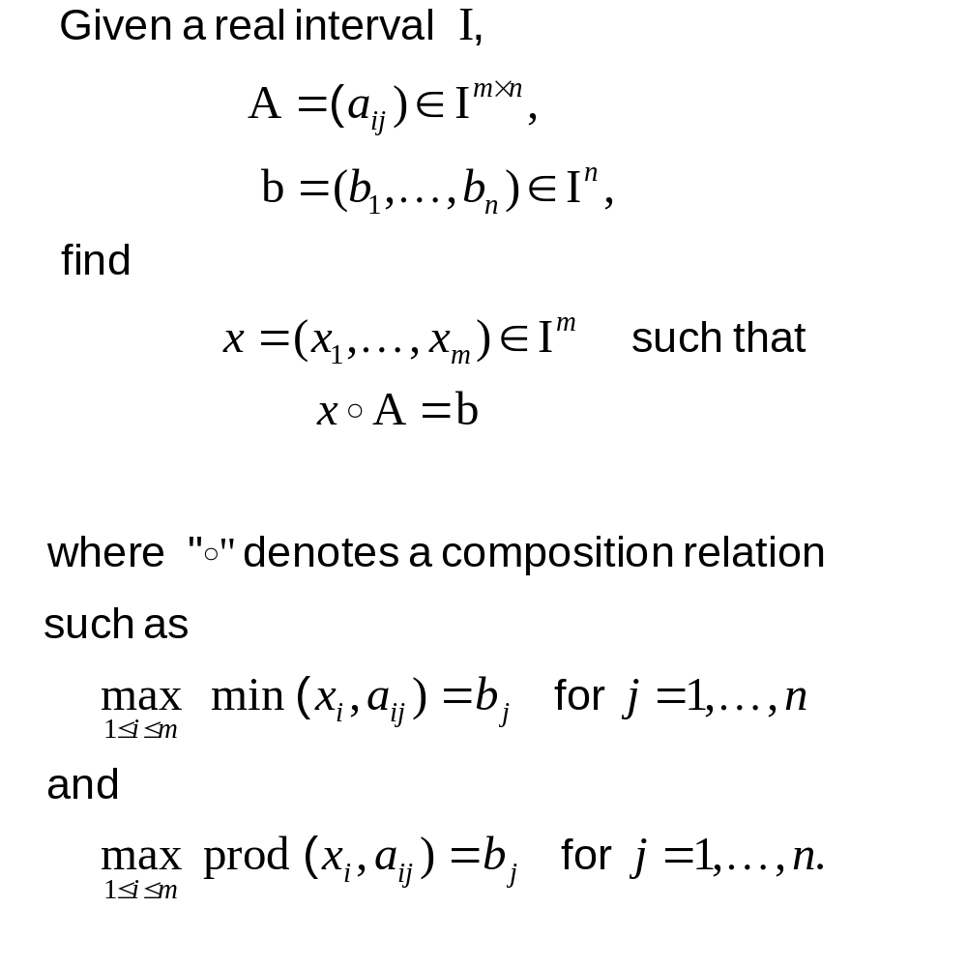
Relational Equations

Slide 4
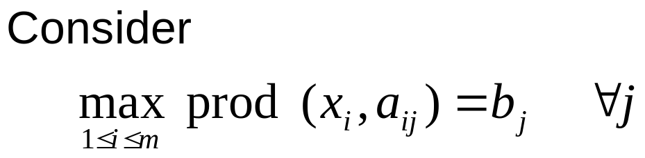
Motivations
Reliability design
Ports
Output
i
j
. . .
a_{ij} : reliability of path (i,j)
b_{j} : required reliability for output j
x_{i} : reliability of port i to be built

Slide 5
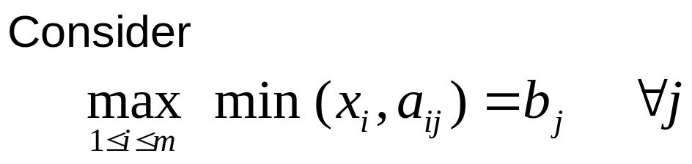
Motivations
Capacity Planning
Regional server
End Users
Multimedia server
j
i
. . .
. . .
a_{ij} : bandwidth in field from server i to user j
b_{j} : bandwidth required by user j
x_{i} : capacity of server i

Slide 6
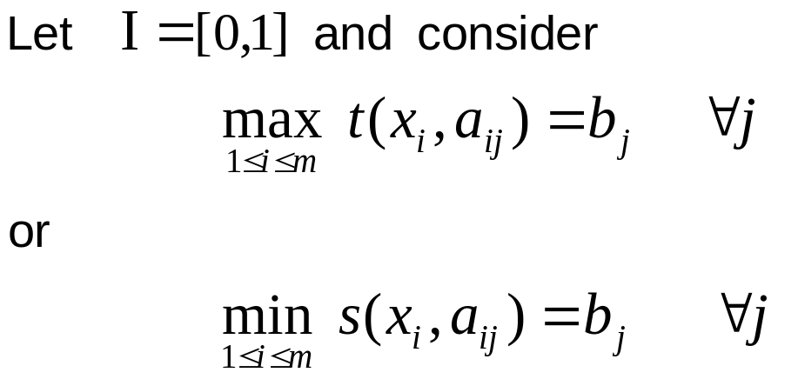
Motivations
Fuzzy control / diagnosis / knowledge system
Input
Output
i
. . .
System
j
. . .
a_{ij} : degree of input i relating to output j
b_{j} : degree of output at j^{th} state (symptom)
x_{i} : degree of input at i^{th} state (cause)

Slide 7
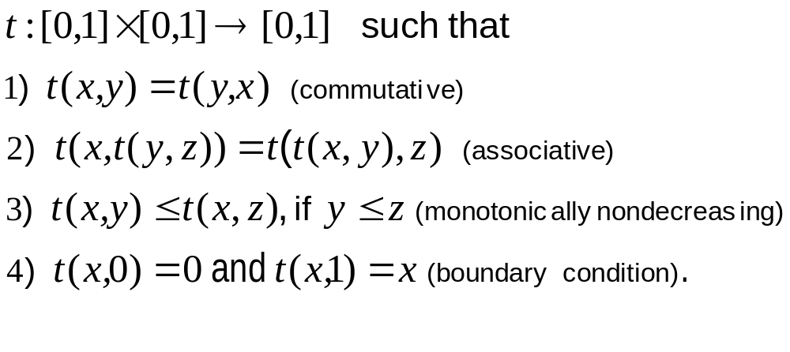
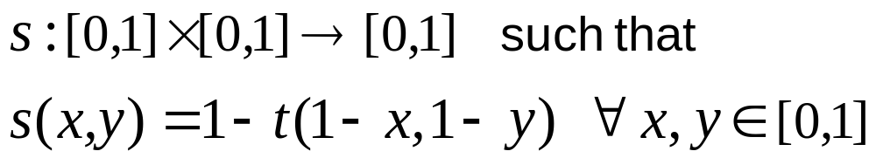
Triangular Norms
[ Schweizer B. and Sklar A. (1961), “Associative functions and statistical triangle inequalities”, Mathematical Debrecen 8, 169-186.]
t-norm:
s-norm (t co-norm):

Slide 8
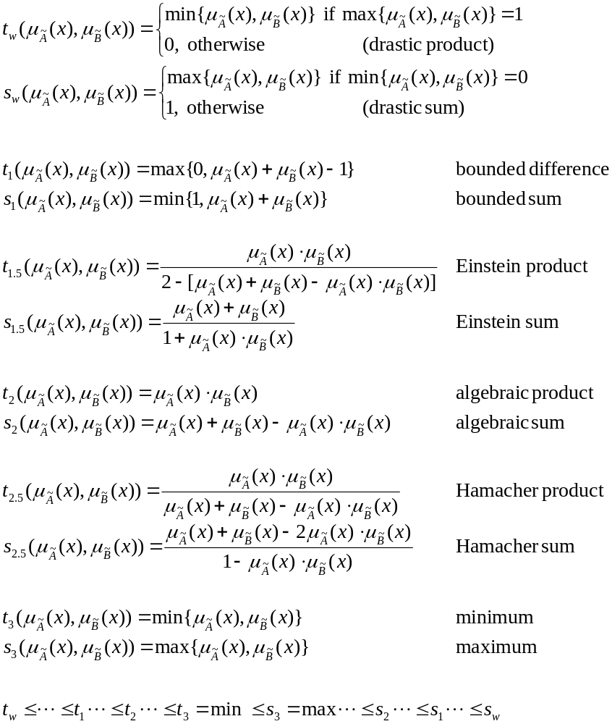
Triangular Norms

Slide 9
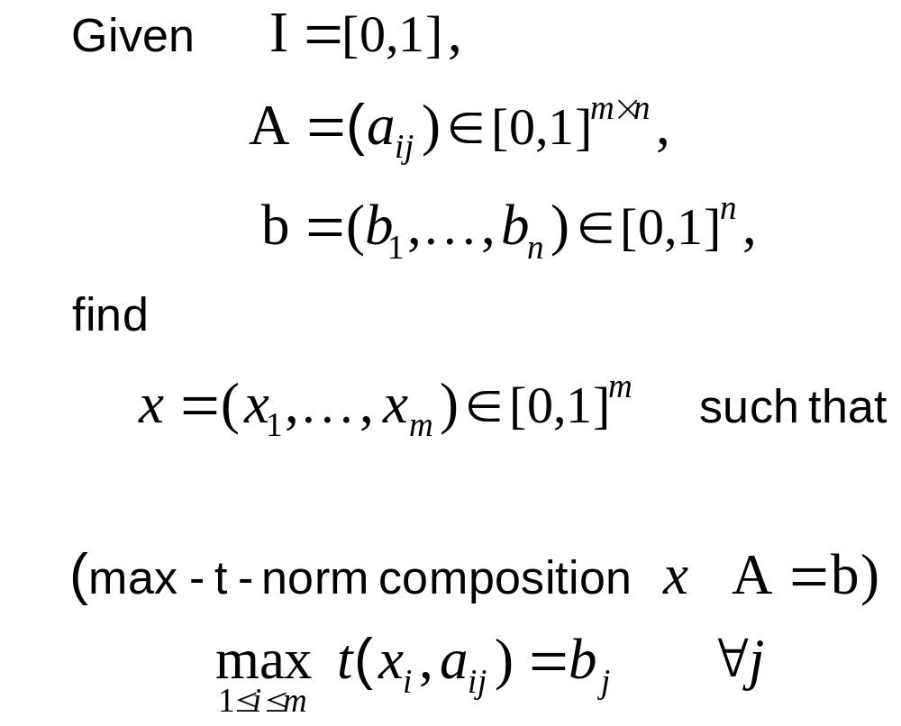
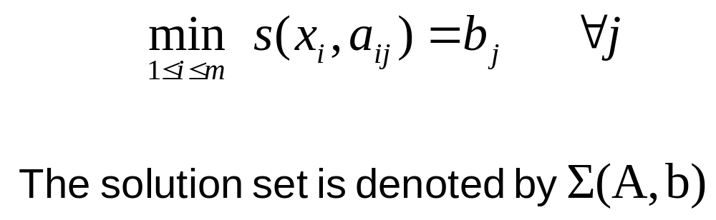
Fuzzy Relational Equations
t
(min - s - norm composition x A = b)
s

Slide 10
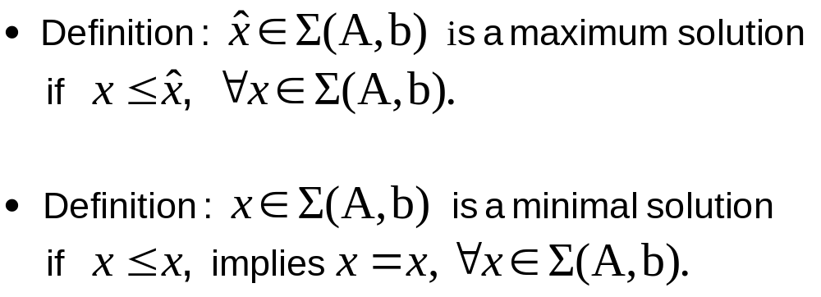

Characteristics of Solution Sets
Theorem: For a continuous t-norm, if Σ(A,b) is nonempty, then Σ(A,b) can be completely determined by one maximum and a finite number of minimal solutions.
[Czogala / Drewhiak / Pedrycz (1982), Higashi / Klir (1984), di Nola (1985)]
x
x
. . .
x
1
2
k

Slide 11
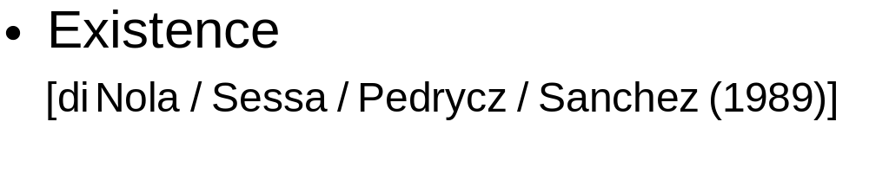
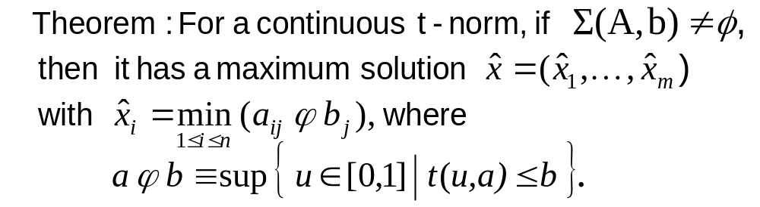
Characteristics of Solution Sets
Uniqueness
[Sessa S. (1989), “Finite fuzzy relation equations with a unique solution in complete Brouwerian lattices,” Fuzzy Sets and Systems 29, 103-113.]
Complexity
[Wang / Sessa/ di Nola/ Pedrycz (1984), “How many lower solutions does a fuzzy relation have?,” BUSEFAL 18, 67-74.]
upper bound = m^{n}

Slide 12
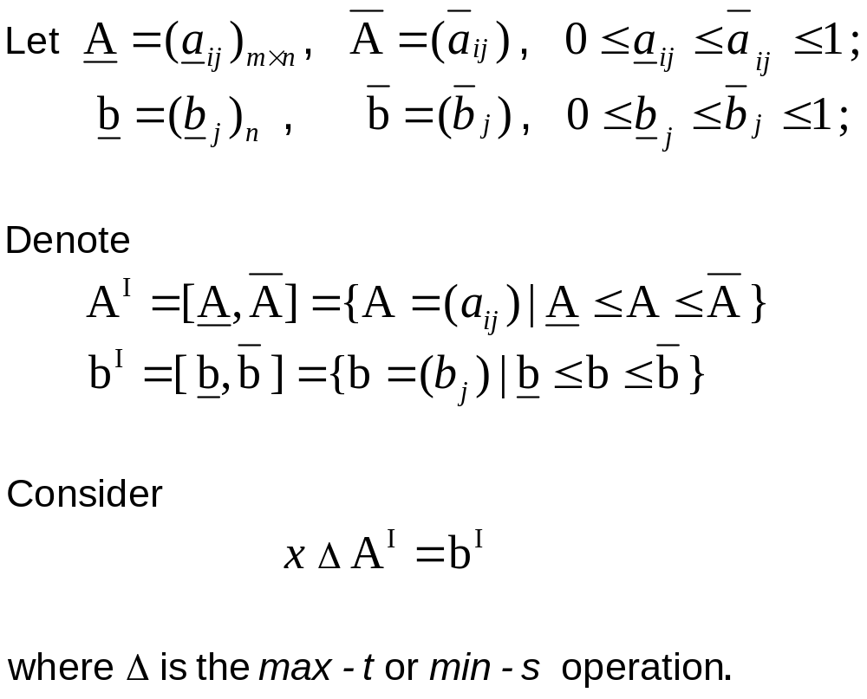
Extensions
Interval Valued Fuzzy Relation Equations (IVFRE)
Imprecise information/estimation data leads to the
use of interval numbers

Slide 13
Solution Concepts of IVFRE
[Neumaier, A. (1990), “Interval Methods for Systems of Equations,” Cambridge University Press.]
Definitions:
The tolerable solution set ∑_{T}(A^{I}, b^{I})
{x ∈ [0,1]^{m} | for each A ∈ A^{I}, there exists b ∈ b^{I} such that x Δ A = b}.
The united solution set ∑_{U}(A^{I}, b^{I})
{x ∈ [0,1]^{m} | there exists A ∈ A^{I} and b ∈ b^{I} such that x Δ A = b}.
The controllable solution set ∑_{C}(A^{I}, b^{I})
{x ∈ [0,1]^{m} | for each b ∈ b^{I} , there exists A ∈ A^{I} such that x Δ A = b}.

Slide 14
Systematic Approach
[Wang / Fang / Nuttle (2002), “Solution Sets of Interval-Valued fuzzy relation equations,” Fuzzy Optimization and Decision Making 2.]
For continuous t-norm / s-norm
Equivalent inequality systems
Max-t
Min-s
Tolerable Solution
x t A ≥ b
x t Ā ≤ b
x ∈ [0,1]^{m}
x s A ≥ b
x s Ā ≤ b
x ∈ [0,1]^{m}
United Solution
x t A ≤ b
x t Ā ≥ b
x ∈ [0,1]^{m}
x s A ≤ b
x s Ā ≥ b
x ∈ [0,1]^{m}
Controllable Solution
x t A ≤ b
x t Ā ≥ b
x ∈ [0,1]^{m}
x s A ≤ b
x s Ā ≥ b
x ∈ [0,1]^{m}

Slide 15
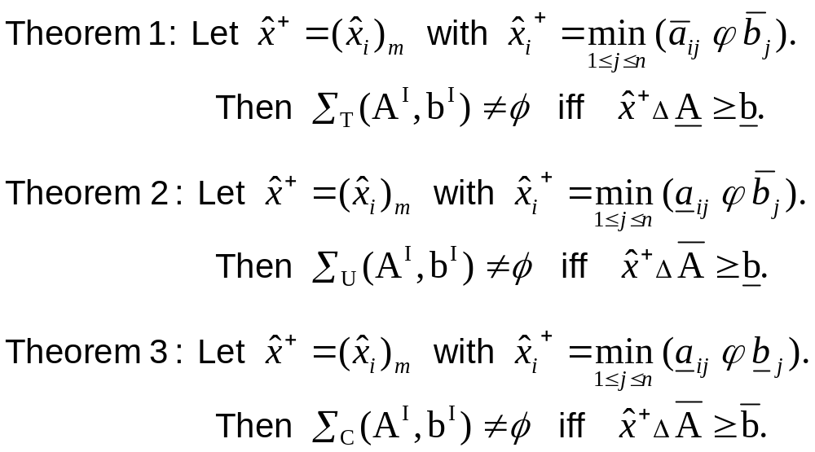
Main Results
Theorem 4:
For max-t composition,
  If ∑_{J}(A^{I}, b^{I} ) ≠, then ∑_{J}(A^{I}, b^{I} ) can be completely determined by one maximum and a finite number of minimal solutions. J∈{T,U,C}
For min-s composition,
  If ∑_{J}(A^{I}, b^{I} ) ≠, then ∑_{J}(A^{I}, b^{I} ) can be completely determined by one minimum and a finite number of maximal solutions. J∈{T,U,C}

Slide 16

Relationship among Solution Sets
x¹ t A^{I}
x¹
b^{I}
x⁴
x⁴ t A^{I}
_{T}(A^{I},b^{I})
_{U}(A^{I},b^{I})
Max-t-norm tolerable solution set
x¹ t A^{I}
x¹
b^{I}
x²
x² t A^{I}
x³
x³ t A^{I}
_{U}(A^{I},b^{I})
Max-t-norm united solution set
x⁵
x⁵ t A^{I}
b^{I}
x³
x³ t A^{I}
_{C}(A^{I},b^{I})
_{U}(A^{I},b^{I})
Max-t-norm controllable solution set

Slide 17
Relationship among Solution Sets
_{U}(A^{I},b^{I})
_{T}(A^{I},b^{I})
x
I
b^{I}
x¹
1
S A
x⁴
x
4
S
A^{I}
Min-s-norm tolerable solution set
x
1
I
_{U}(A^{I},b^{I})
S A
x¹
b^{I}
x
2
I
x²
S A
x³
x
3
I
S A
Min-s-norm united solution set
_{U}(A^{I},b^{I})
b^{I}
_{C}(A^{I},b^{I})
x
5
I
S A
x⁵
I
x³
x
3
S A
Min-s-norm controllable solution set

Slide 18
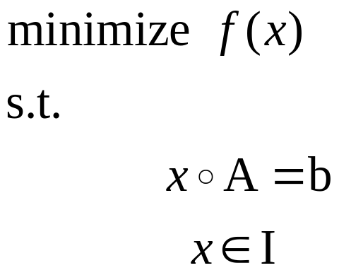
Extensions
II. Optimization with Fuzzy Relation Equation Constraints

Slide 19
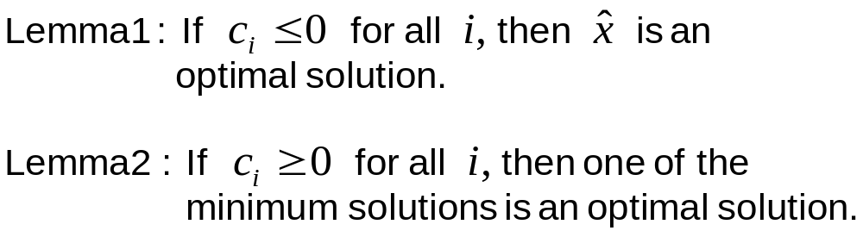
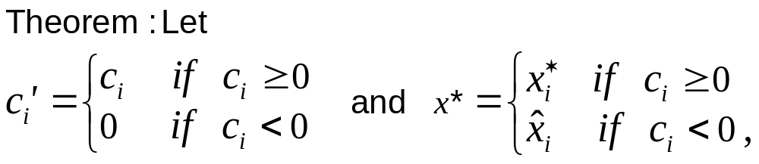
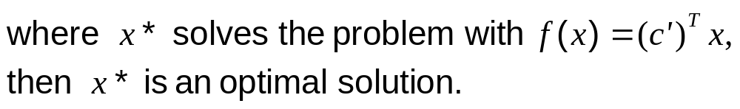
Optimization with Fuzzy Relation Equations
(a) f (x)=c^{T}x linear function
[Fang / Li (1999), “Solving fuzzy relation equations with a linear objective function, Fuzzy Sets and Systems 103, 107-113.]
0-1 integer programming with a branch-and-bound solution technique.

Slide 20
Optimization with Fuzzy Relation Equations
(b) f (x) is nonlinear
[Lu / Fang (2001), “Solving nonlinear optimization problems with fuzzy relation equation constraints,” Fuzzy Sets and Systems 119, 1-20.]
Non-convex optimization problem with a genetic algorithm.
(c) f (x) is vector valued
[Loetamonphong / Fang / Young (2002), “Multi-objective optimization problems with fuzzy relation equation constraints,” Fuzzy Sets and Systems 127, 141-164.]
Pareto optimal front with a genetic-based solution procedure.

Slide 21
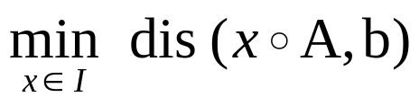
Challenges Remain
Efficient solution procedures to generate ∑(A, b) and ∑(A^{I}, b^{I} )
Efficient algorithms for optimization problems with relation equation constraints
Efficient algorithms to generate an approximate solution of ∑(A, b) and
∑(A^{I}, b^{I} ), i.e.,

